Slide 1
A3 Music website (concept note and wireframes)
- Ananya Chandorkar

Slide 2
Concept Note:
The website that we are making is a music website that showcases our music tastes. There will be five languages that we thought of including to give some variety-
English (old songs)
Hindi (old and new songs)
Gujarati (new songs)
Marathi (old and new songs)
We also thought of showing the languages by using carousel.
We also thought of showing a shuffled list of all songs.
We are going to extract songs from cassettes, cd’s, amazon music and include them.

Slide 3
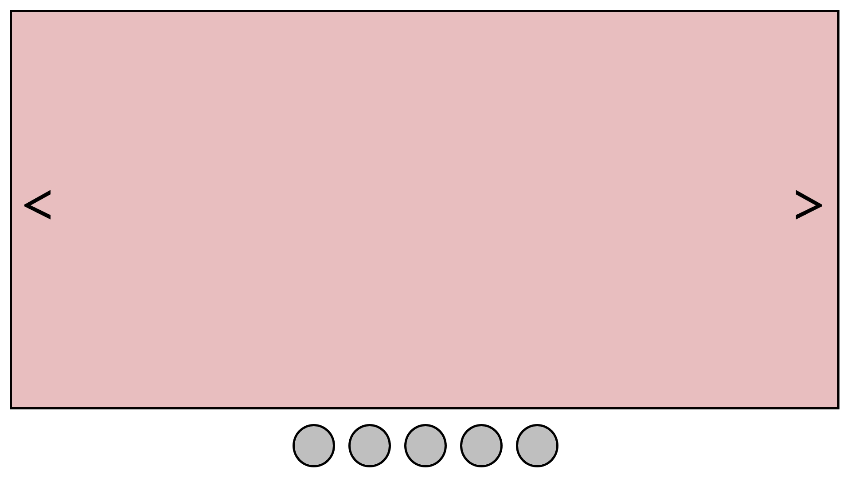
Wireframe 1
(English songs)

Slide 4
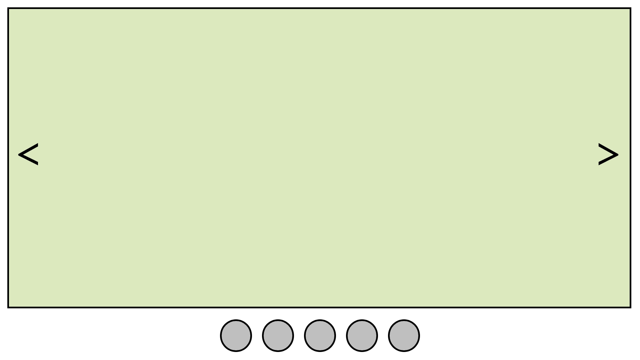
Wireframe 2
(Hindi songs)

Slide 5
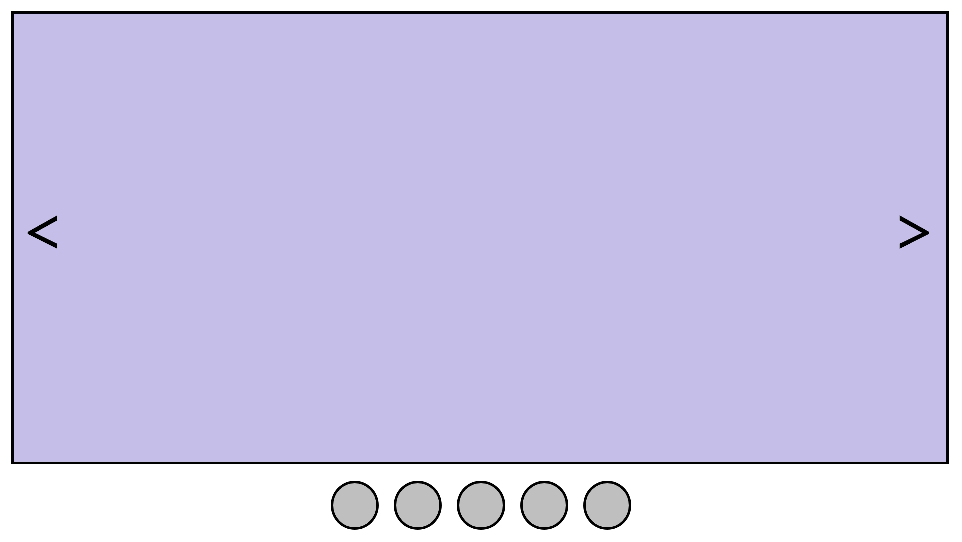
Wireframe 3
(Gujarati songs)

Slide 6
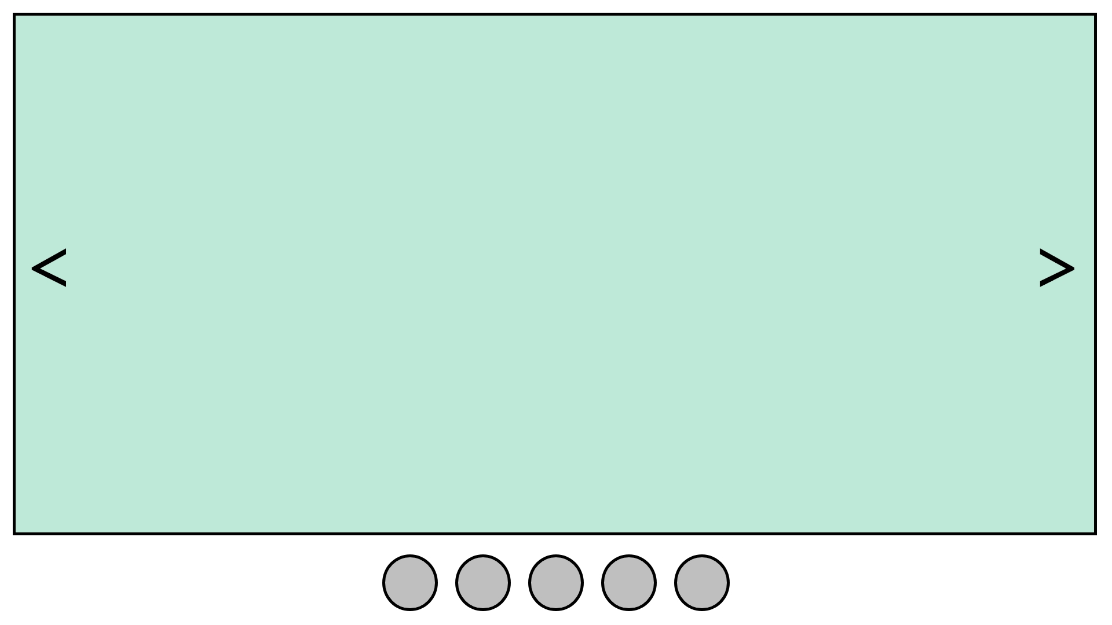
Wireframe 4
(Marathi songs)

Slide 7
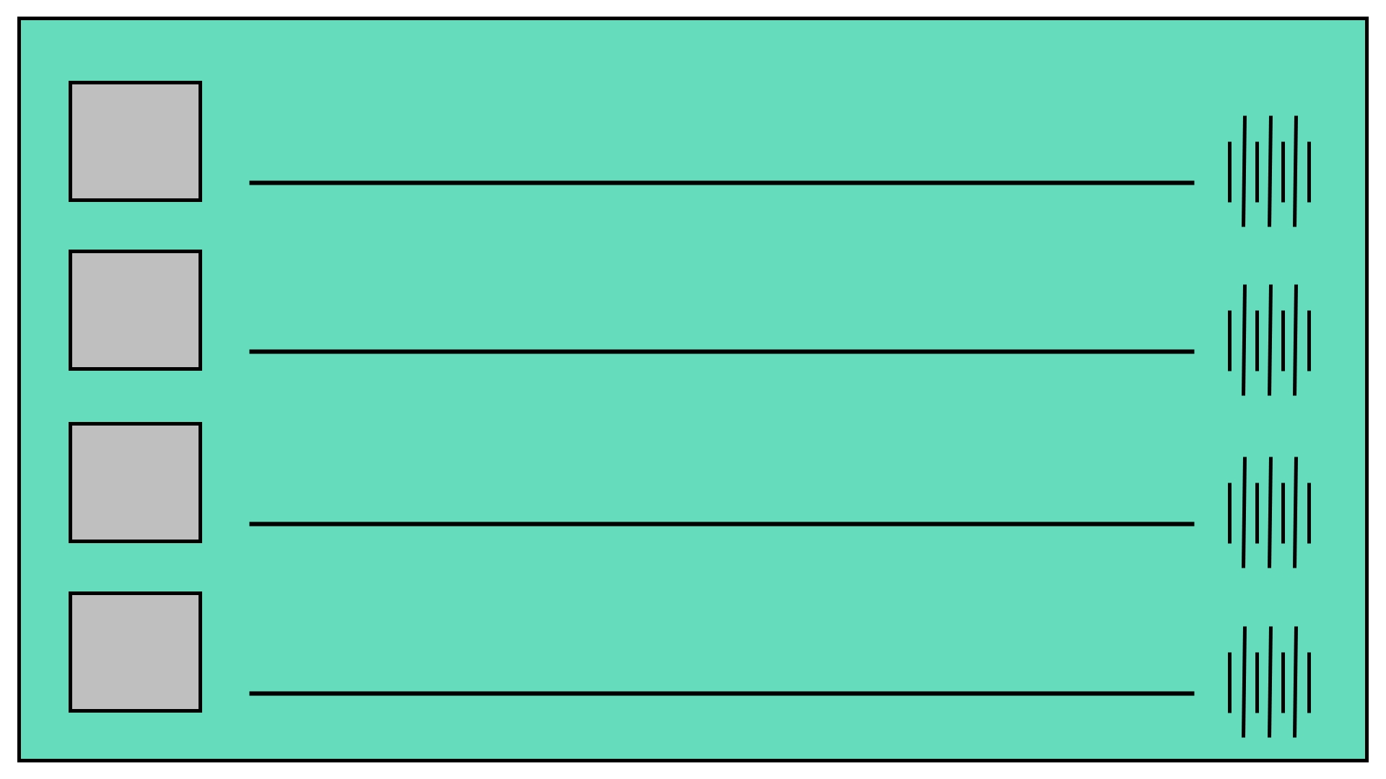
Wireframe 6
(Song list)

Slide 8
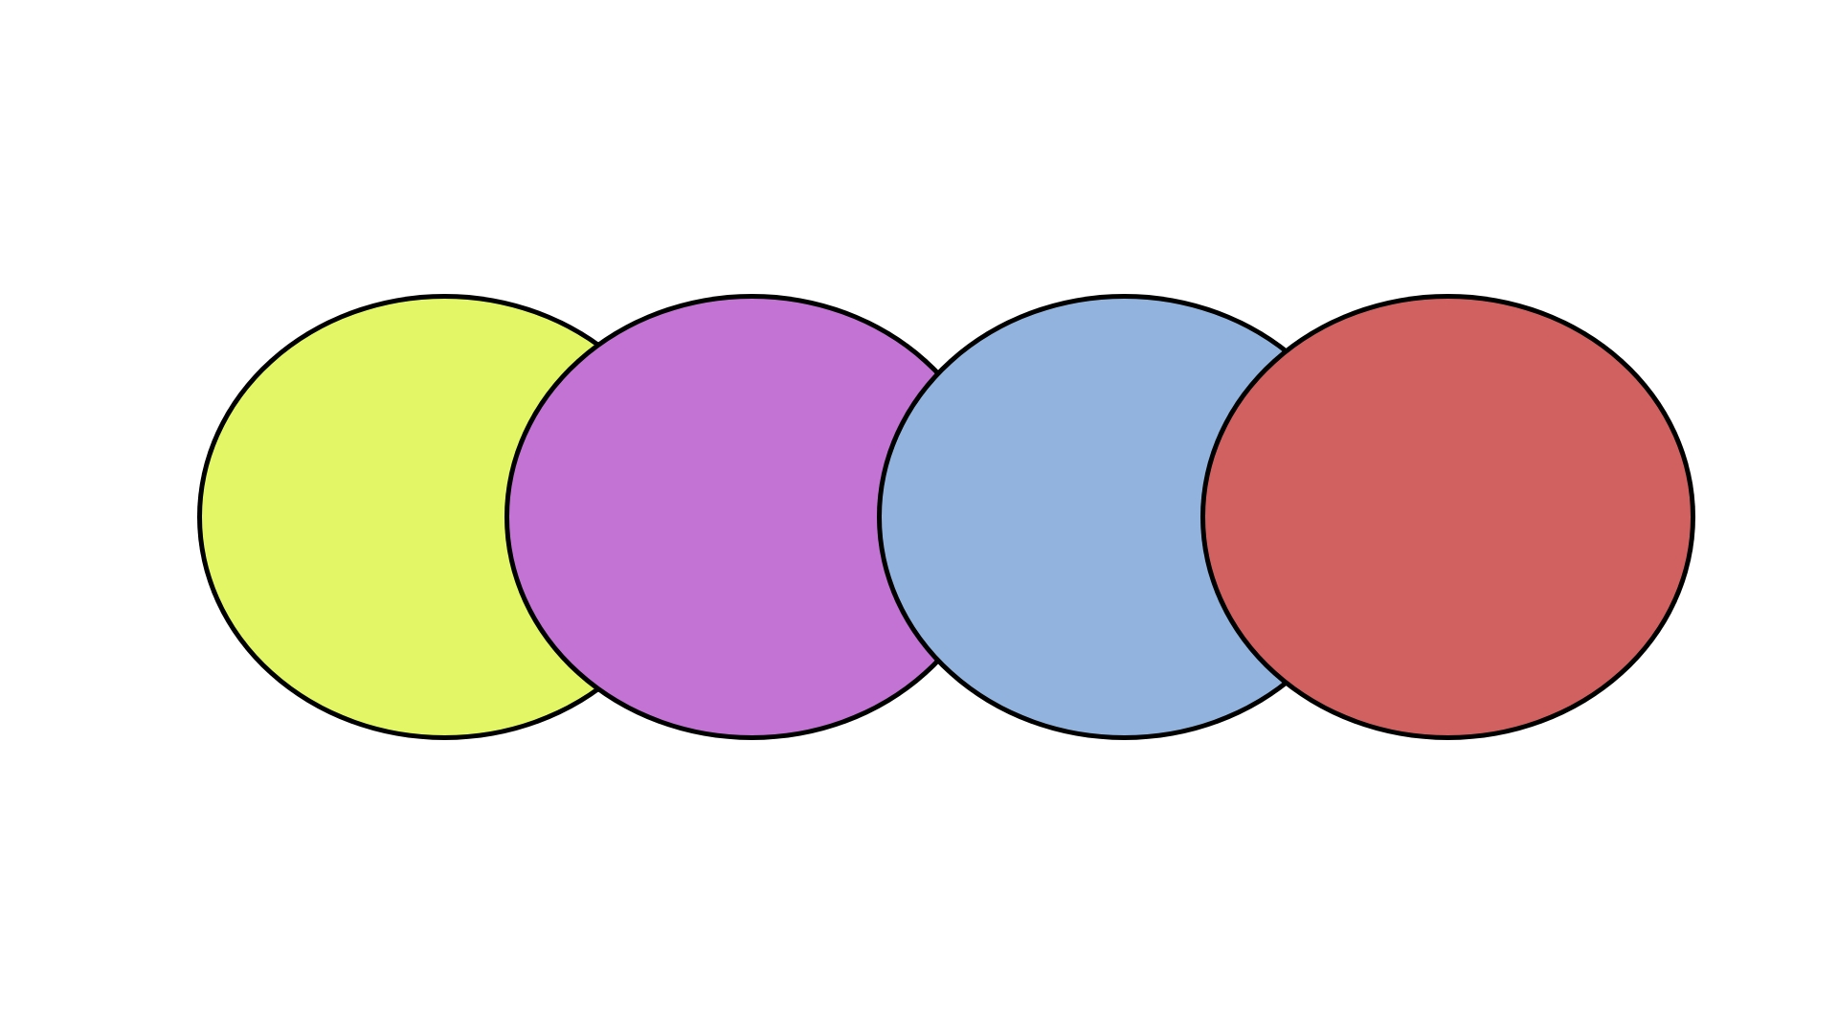
Wireframe 7
(Artists)

Slide 9
Thank you!

